Slide 1



Music Genre Classifier
Group 10:
Idil Bil
Mehmet Berke Karadayi
Peter Na
MUSIC GENRE
CLASSIFIER
1

Slide 2

Music Genre Classifier
2

Slide 3
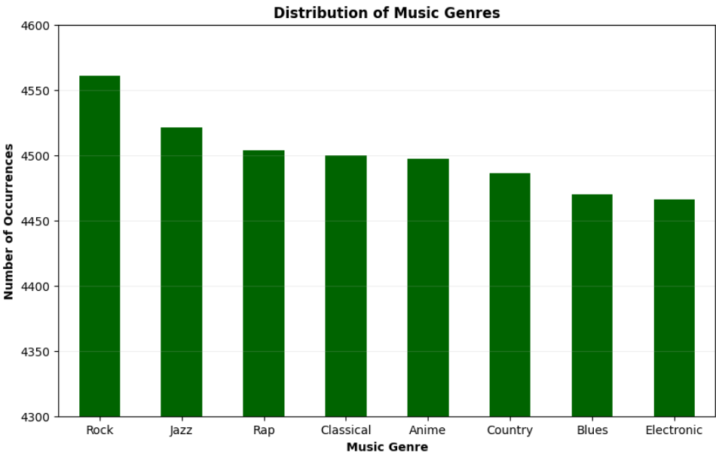
Music Genre Classifier
DATASET
Selected a music metadata set with various song features
Wanted to focus on how different musical attributes relate to genres
Features
artist and song name
popularity
tempo
danceability
...
Exploratory Data Analysis
Dropped irrelevant columns
Dropped rows with missing information
3

Slide 4
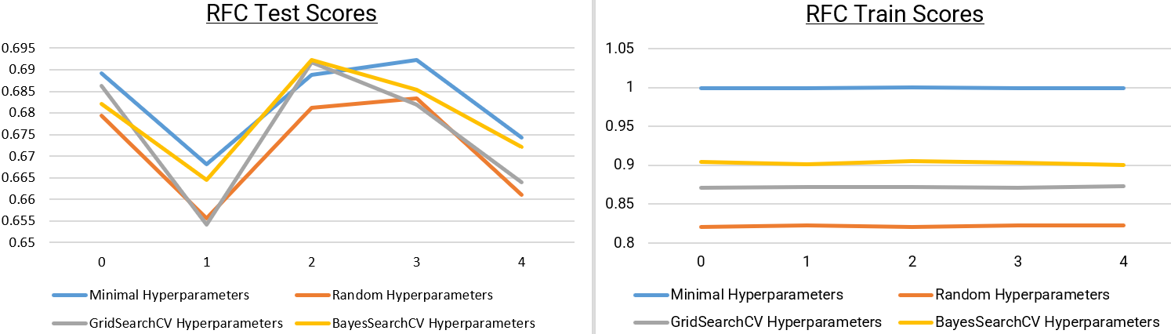
Music Genre Classifier
SUPERVISED LEARNING METHODS 1
Random Forest Classifier
Best Configurations: GridSearchCV and Random Hyperparameters were identified as the top-performing setups for RFC.
Performance: Achieved ~0.68-0.69 test scores with similar train scores, reducing overfitting.
Combining outputs from multiple decision trees to handle high-dimensional data.
4

Slide 5
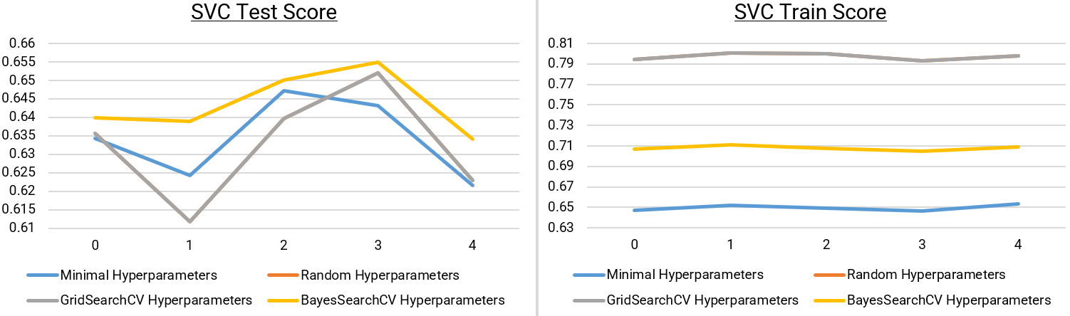
Music Genre Classifier
SUPERVISED LEARNING METHODS 2
Support Vector Classifier
Best Configuration: The Random Hyperparameters setup was the top performer for SVC.
Performance: Achieved a test score of ~0.65 with consistent train scores.
Classifies data by finding the hyperplane that maximizes the margin between classes.
5

Slide 6
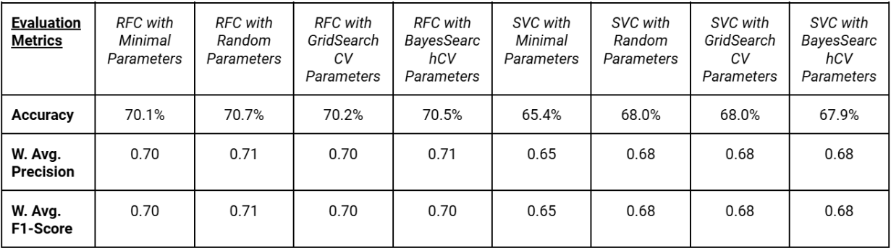
Music Genre Classifier
Metrics Chosen
EVALUATION
Precision: Reliability of predictions for each genre. More important than recall because minimizing incorrect genre labels is prioritized
F1-score: Balances precision and recall, important for evaluating performance on less frequent music genres
Accuracy: Overall correctness, may be misleading with imbalanced classes
6

Slide 7
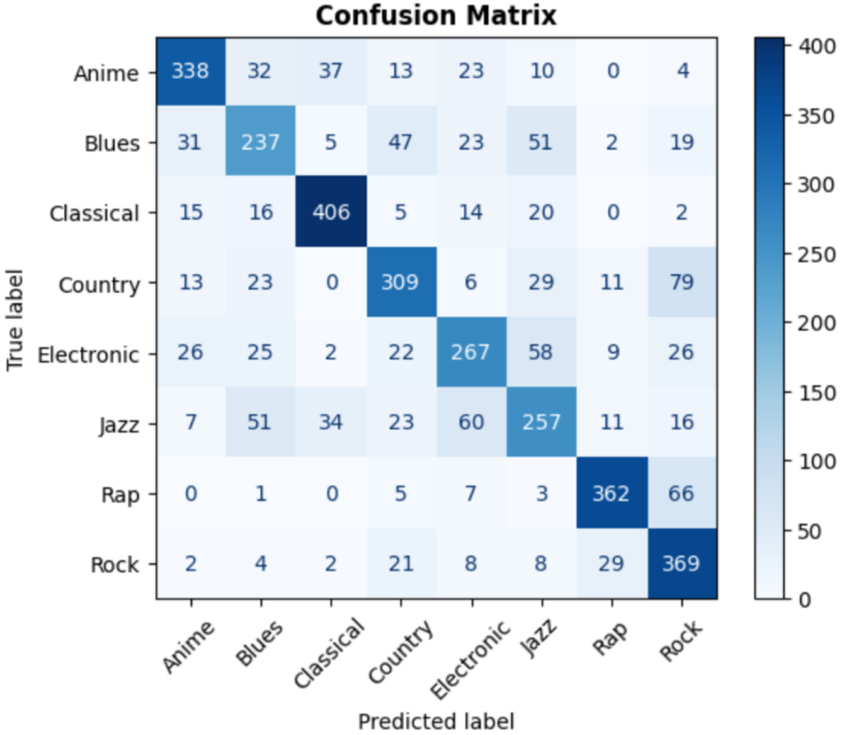
Music Genre Classifier
CONFUSION MATRIX
Strengths:
Good overall performance, especially with genres like Classical, Rap, Rock, and Anime
Areas of Confusion:
79 Country songs misclassified as Rock
66 Rap songs misclassified as Rock
~60 songs of Jazz and Electronics misclassified as the other
Takeaway:
Further tuning to differentiate between genres of confusion
7

Slide 8

Music Genre Classifier
DISCUSSION
Challenge 1 - Data Type Conversion
Needed to convert string-type features into numerical values
First used the Label Encoder function, which impacted the weights
Switched to One-Hot Encoding, which encodes unique values with 1s and 0s
Challenge 2 - Tuning Hyperparameters
Minimal parameters to avoid overfitting
Gradually increased the number of parameters
Explored GridSearchCV and BayesSearchCV
8

Slide 9






Music Genre Classifier
THANK YOU FOR LISTENING
9

